Slide 1

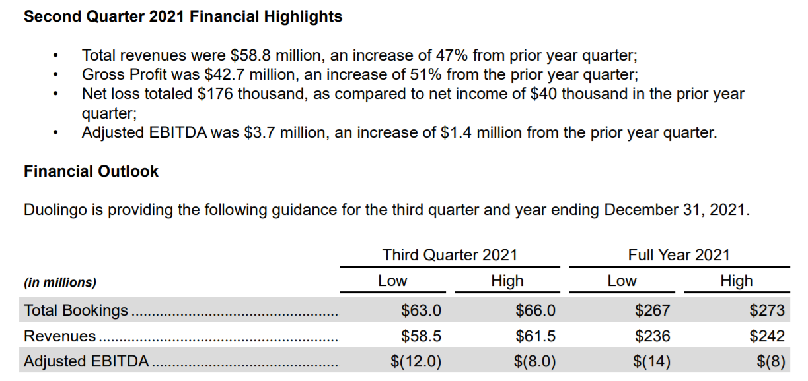
Augmenting The Readability and Traceability of Software Documentation
From Bulge Bracket Investment Banking to Software Engineering Research

Slide 2




IPO: Initial Public Offering
Offering shares of a private corporation to the public
Why?
Raise capital
Increase exposure
Prestige
Memes

Slide 3
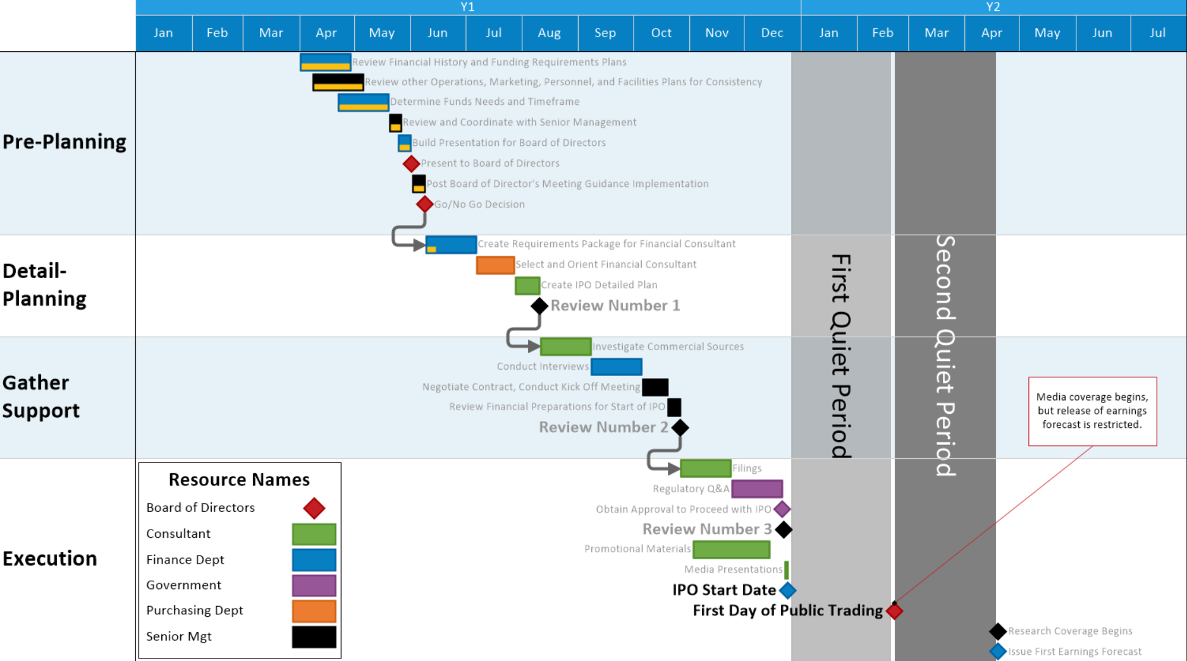
Role of the investment bank for client IPO
Audit internal resources: accounting, legal, FP&A (i.e., financial health)
Financial and legal modeling
Prepare IPO documentation for SEC review
Prepare S-1 filing (IPO registration for investor due diligence)

Slide 4


My Role
Tracing SEC requirements with client financial statements within last 5 years

Slide 5
VP: Try Compooters
Observations and Questions
Me: Aight bet
Corporations strategize around quarterly earning reports.
Do software teams care about release documentation?
How do software developers write release documentation?
Investors use earning reports to predict, analyze, and justify investment decisions.
Does release note writing style correspond with any software characteristics?
Do these characteristics affect user decisions?
Bankers and accountants audit clients’ financial health through tracing financial documents with SEC regulations.
Can software documentation and source code be traced automatically?

Slide 6

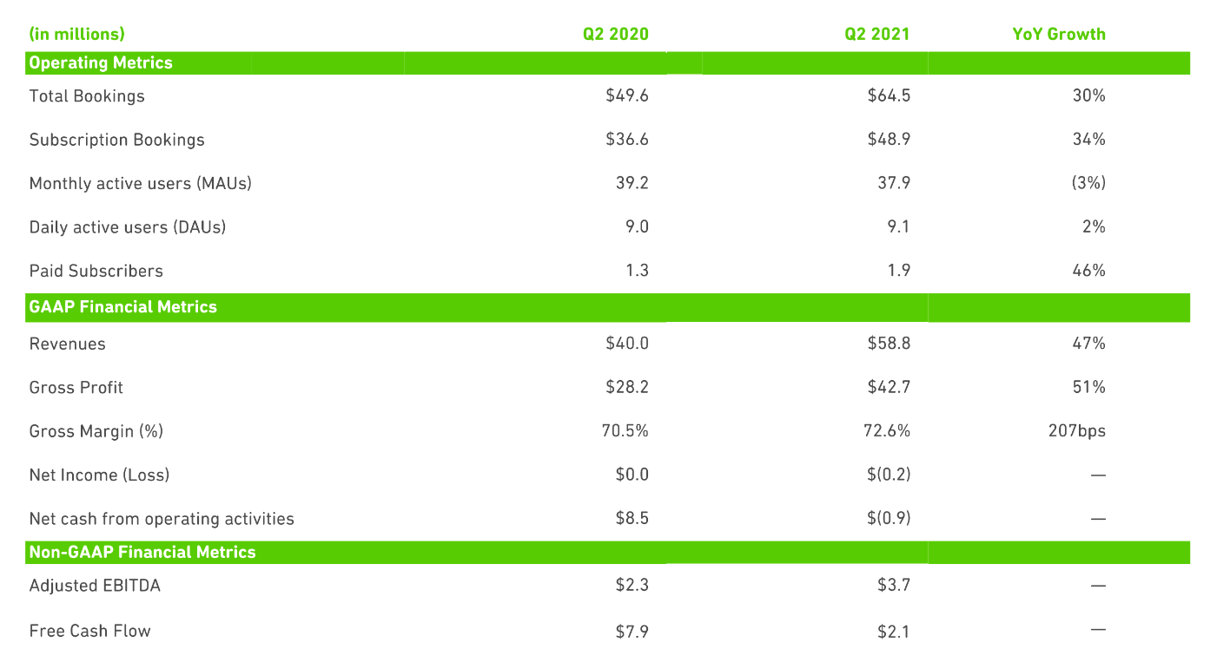
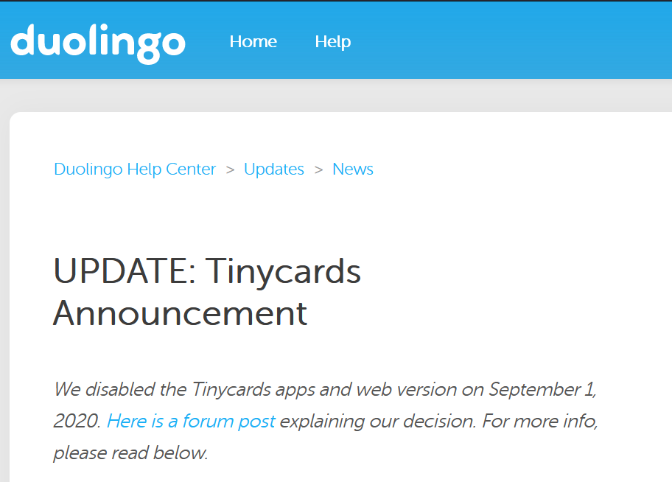

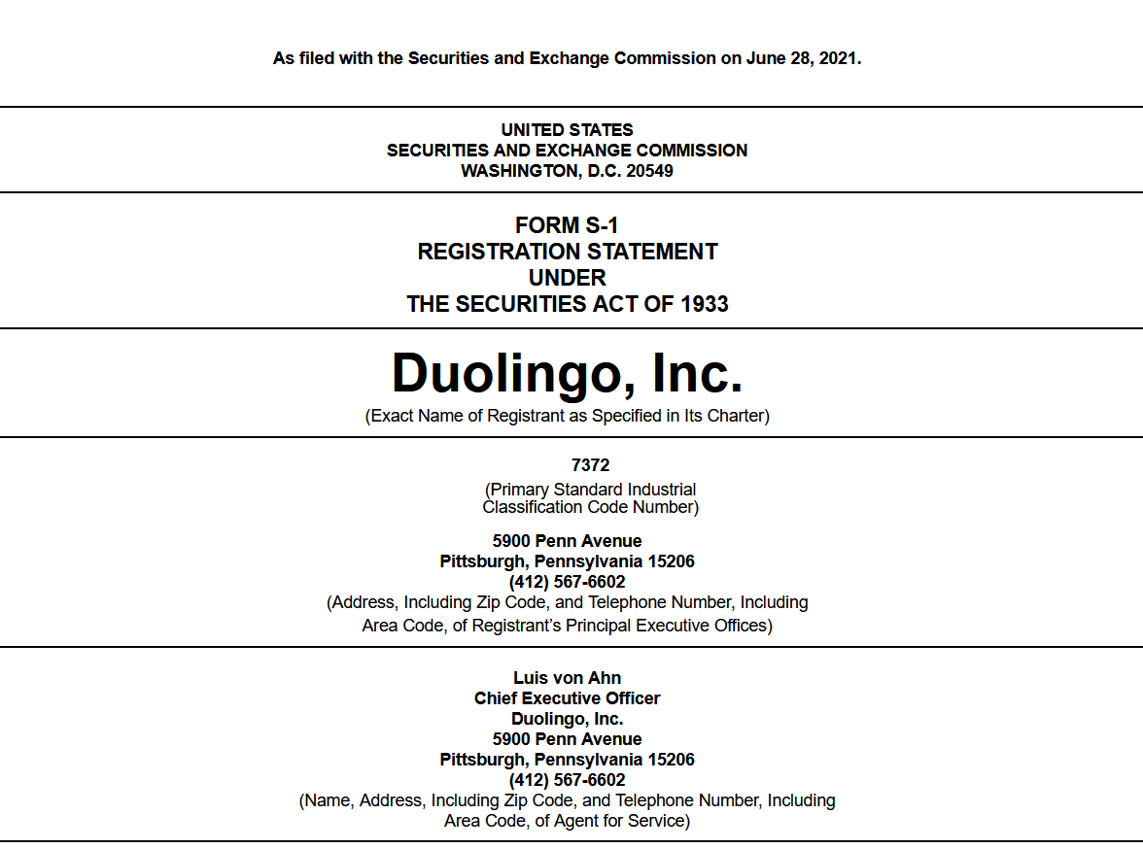

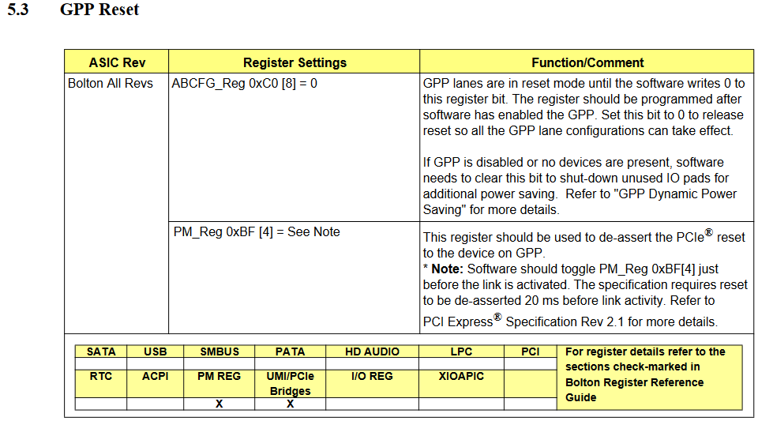


Financial Documents
Software Documents
Earnings report
Accountants
??
IBanks
IPO
forms

Slide 7
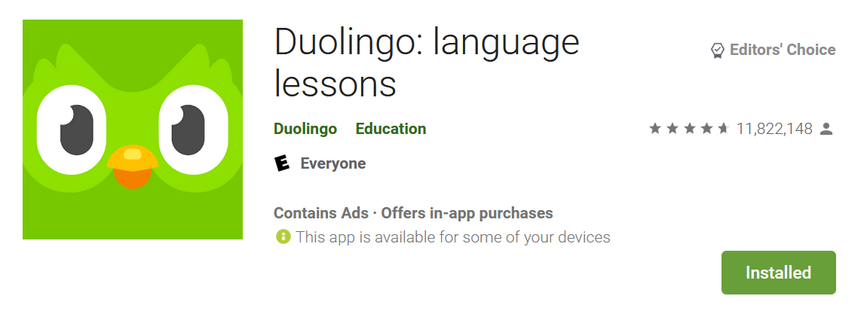

Who Reads Release Notes Anyway?
When you publish release notes instead of saying the blanket bug fixes, maybe you should try to make a useful statement instead.
Setting up fingerprint login should have been announced in the release
notes not hidden in the options!"
User Reviews

Slide 8
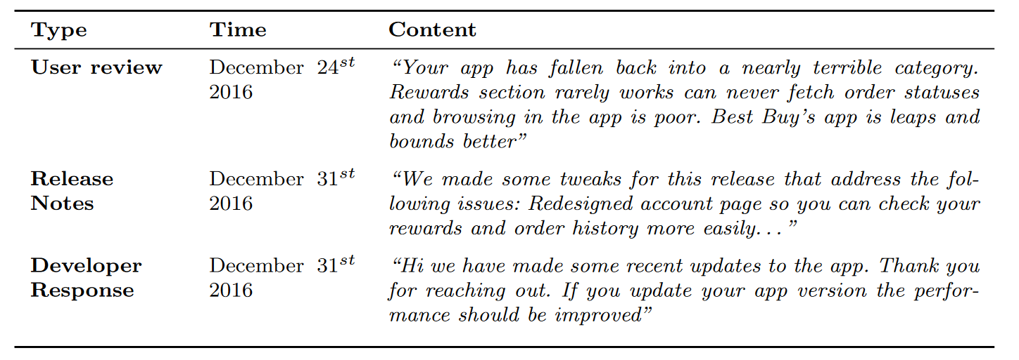
User – Developer Dialogue

Slide 9
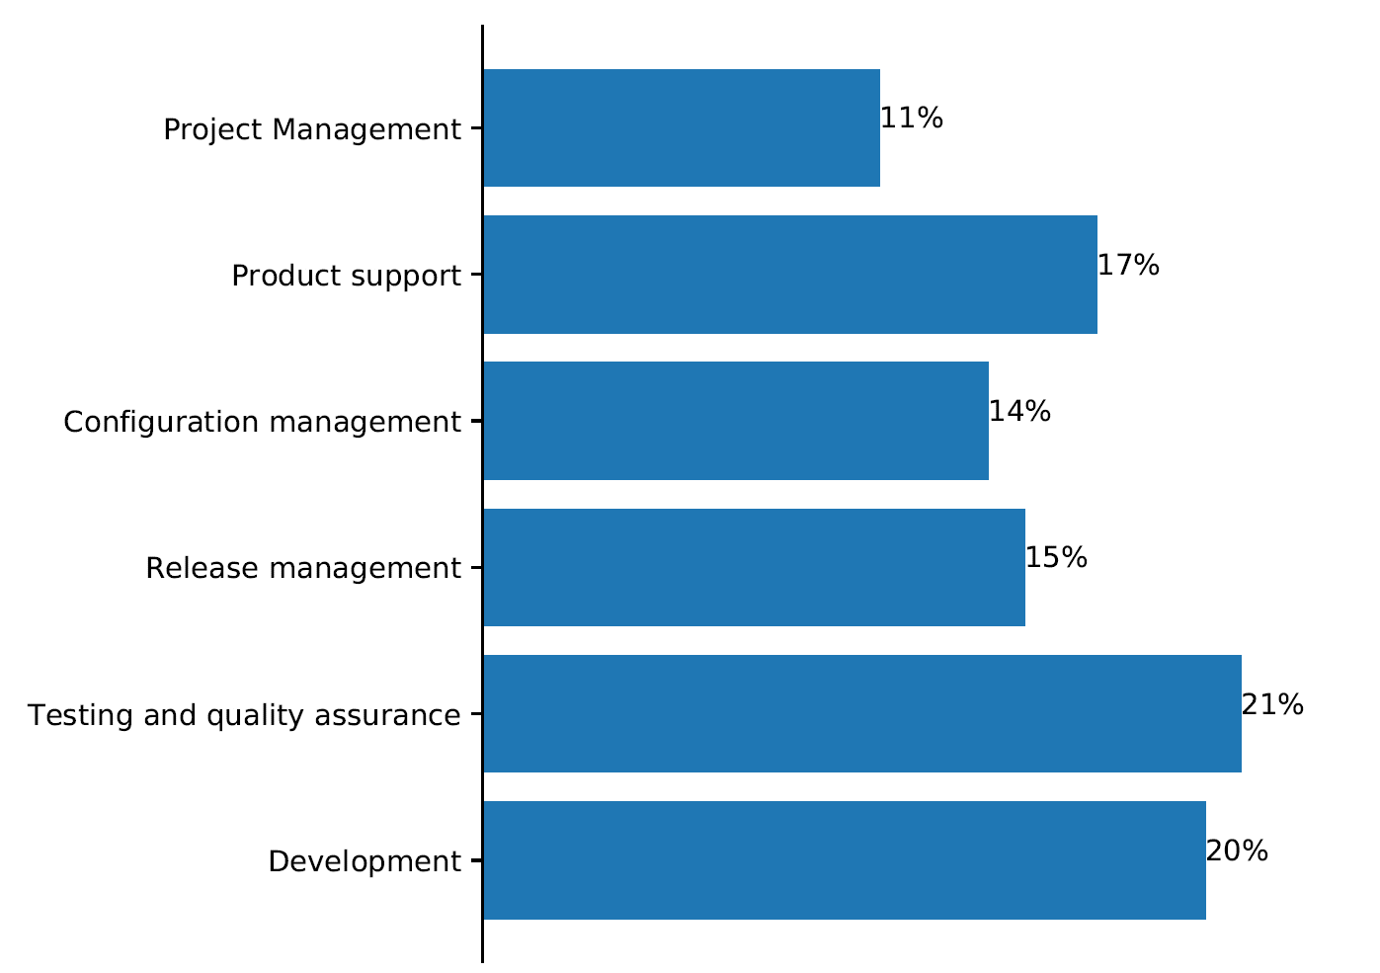
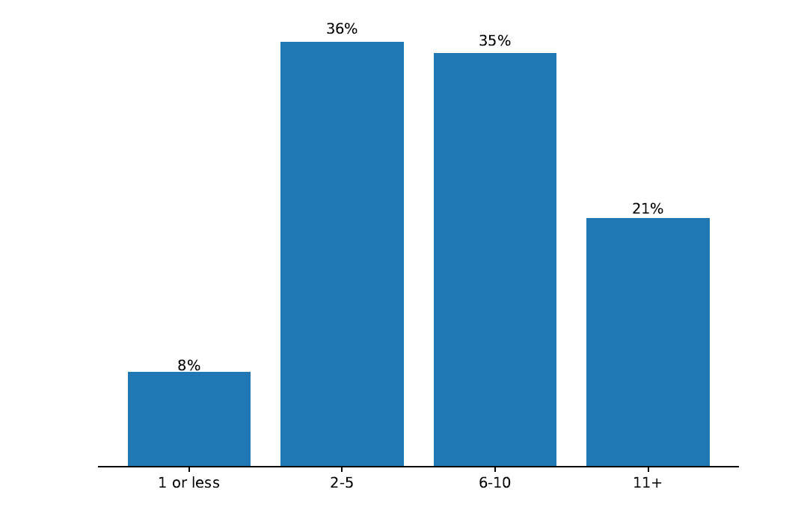
We Surveyed 102 Developers
The distribution of the years of experience of the surveyed developers
The distribution of the job roles of the surveyed developers.

Slide 10
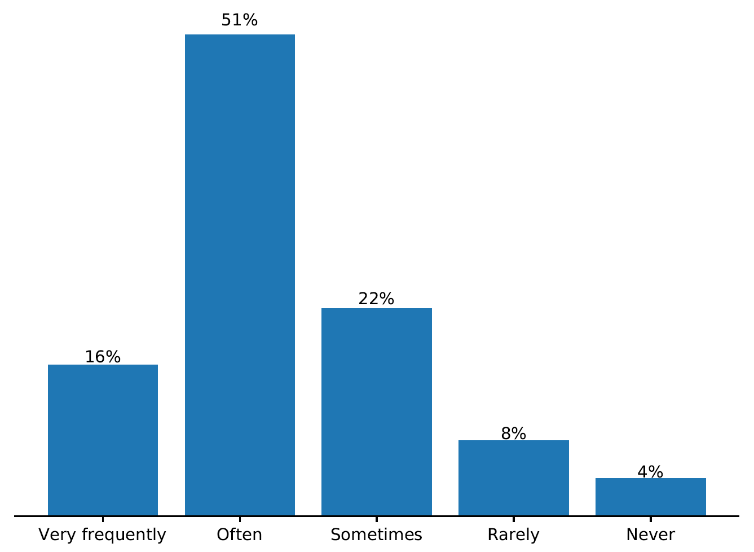
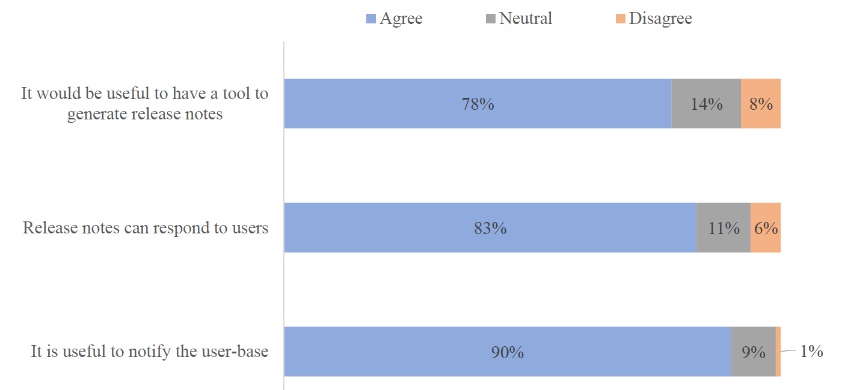
We Surveyed 102 Developers
Developers' answers for frequency of release note update.
Developers' answers for release note uses.

Slide 11
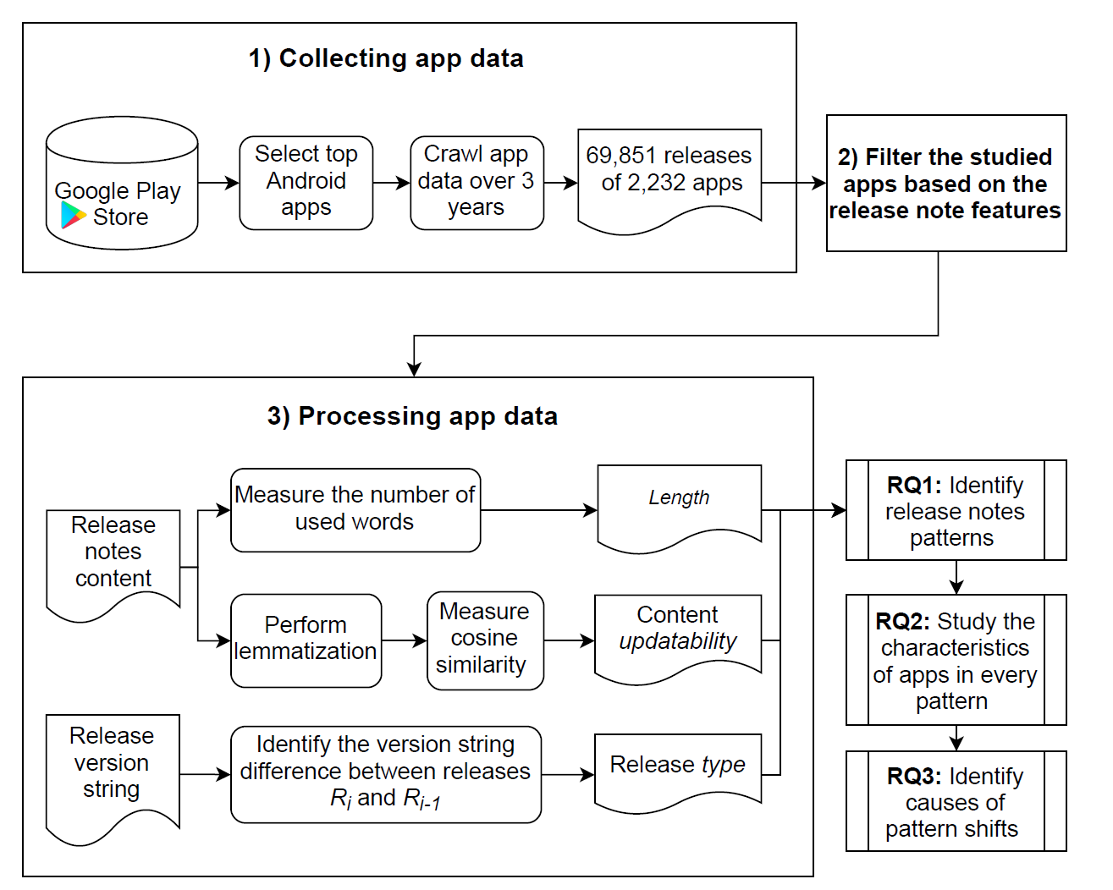
We collected data of the studied 2,232 apps over the period of three years: from April 2016 to April 2019. We collect 69,851 releases, 67,697,919 user reviews and 2,902,944 developer responses.
Data Collection

Slide 12
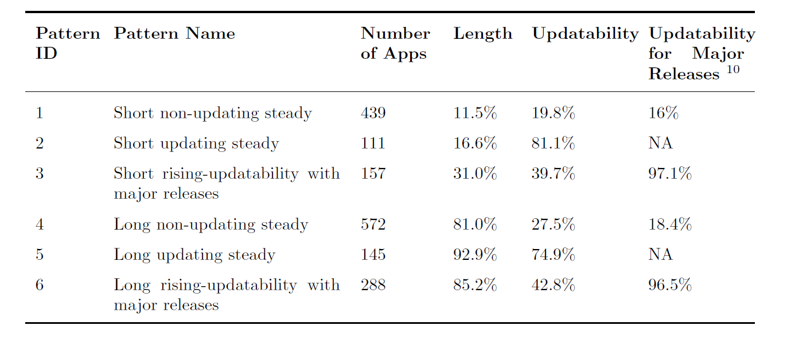
We Observe 6 Release Note Patterns
Example release notes:
GUI enhancements and minor fixes
Fix a bug of the grouping separator. Improved calculation precision

Slide 13
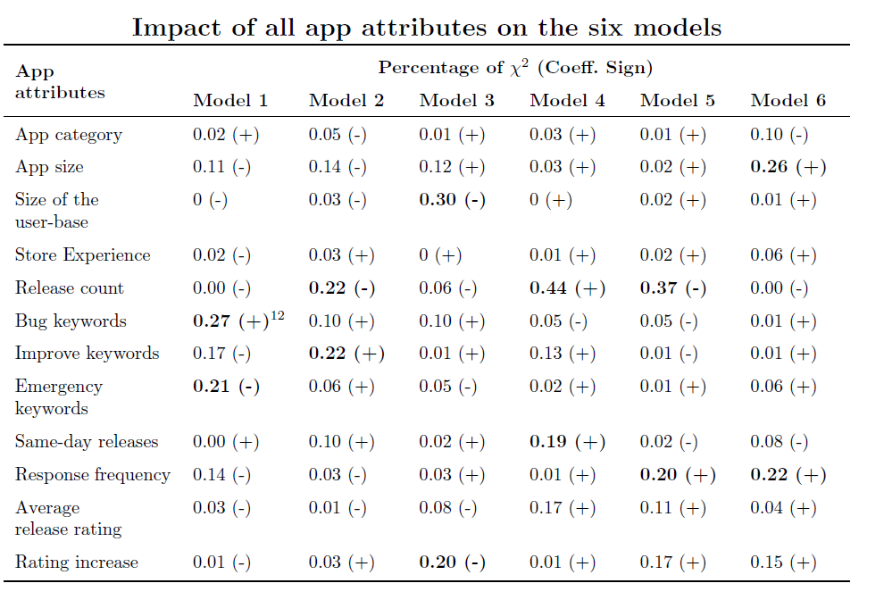
We Observe 6 Release Note Patterns
Build logistic regression model to observe if certain app attributes are correlated with release note patterns.
Identify the attributes that are most contributing to each release notes pattern using Wald statistics (χ2) to estimate the relative contribution.
The larger the χ2 value, the larger the impact that a particular attribute has on the performance of the model

Slide 14
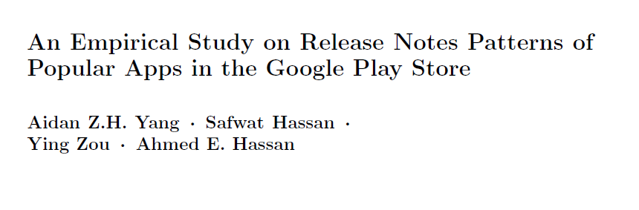
Contributions
We identify six patterns of release notes.
Apps with long and updating release notes have high perceived quality releases, an increase in user ratings, and informative release notes.
Our approach can help store owners notify users with apps that have descriptive release notes and high perceived quality in their deployed releases
Our work shows potential directions for developers to improve the release notes mechanisms in app stores.
To appear at EMSE as:

Slide 15
VP: Try Compooters Me: Aight bet
Observations and Questions
Corporations strategize around quarterly earning reports.
Do software teams care about release documentation?
Yes!
Investors use earning reports to predict, analyze, and justify investment decisions.
Does release note writing style correspond with any software characteristics?
Also yes! Even how users perceive apps
Can software documentation and source code be traced?
Bankers and accountants audit clients’ financial health through tracing financial documents with SEC regulations.

Slide 16
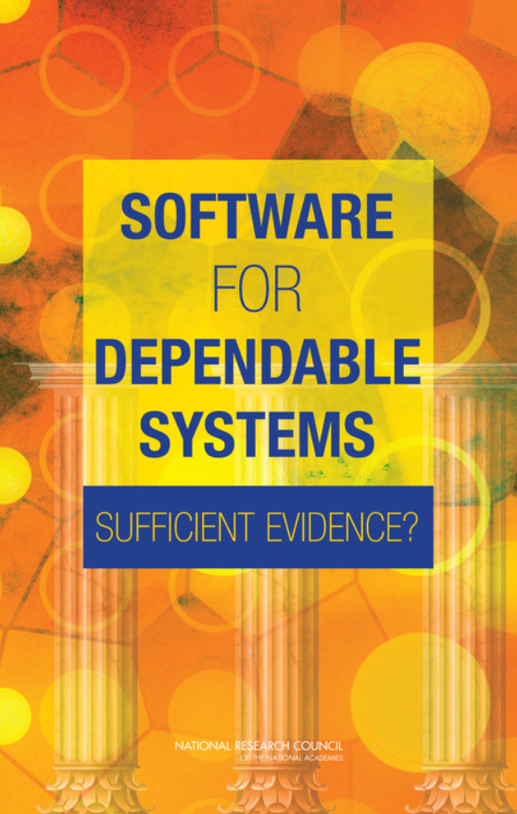
It’s Not Just About the Bugs
Study by the National Academy of Sciences
Failures due to software in:
Aviation, medical devices, energy grids, defense, electronic voting …
Bugs in code only account for 3% of failures
Most failures caused by a poor understanding of system requirements and specification

Slide 17
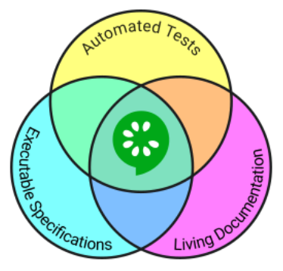
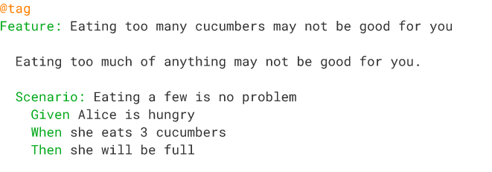
Can Requirements Tracing be Automated?

Slide 18






Behavior Driven Development (BDD) is a New Style of Testing Strategy Based on Test Driven Development
Traditional Testing Strategies
Behavior Driven Development
Test suites
.Feature Files
Execute tests
Fix bugs
Combine behaviors
Construct scenarios
Test suites
Source code
Step def. files

Slide 19
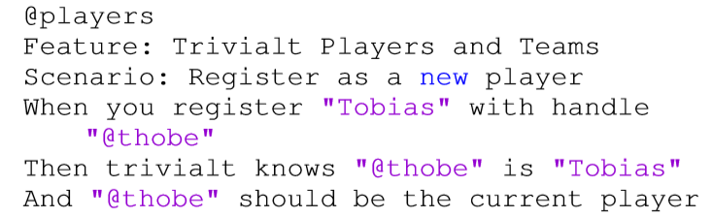
Example .Feature File
.Feature

Slide 20
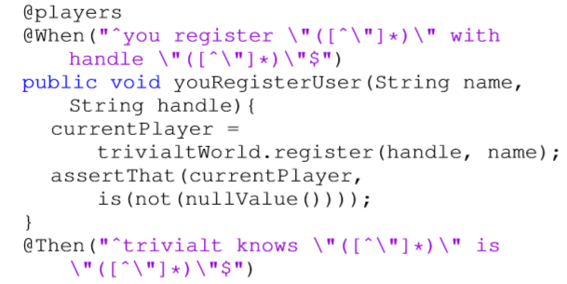
Example Step Definition File
.Feature
Step Definition

Slide 21
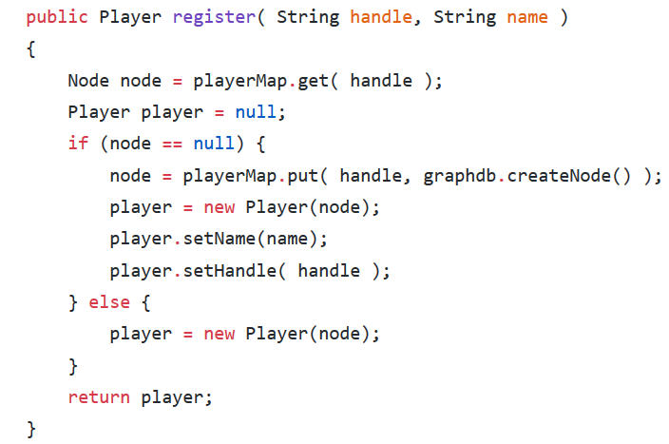
Step Definition File Linkage to Source Code
Step Definition
Source Code

Slide 22
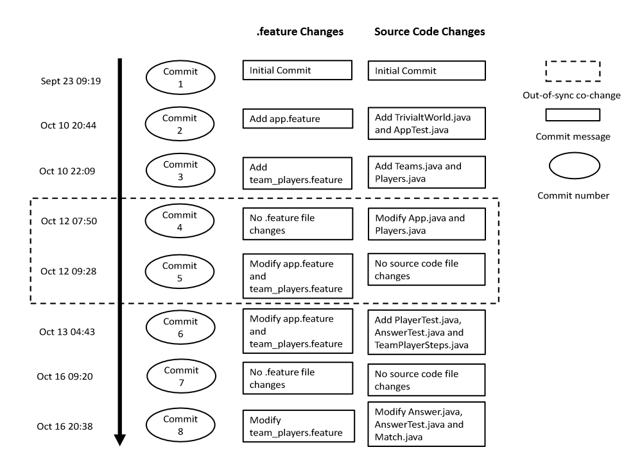
Out-of-sync co-change

Slide 23




Motivation
Out-of-synch co-change reduces benefits of BDD
New developers entering a project struggle to understand requirements
BDD

Slide 24
Motivation
Out-of-synch co-change reduces benefits of BDD
New developers entering a project struggle to understand requirements
BDD
Identify code characteristics that can predict co-changes between .feature files and source code files (BDD co-changes) to help developers reduce out-of-sync BDD co-changes

Slide 25

We Selected 133 BDD Projects for Analysis
GitHub Open Repositories
Select Java projects
Select projects with .feature files
Eliminate BDD commit projects
Select projects with English logs
1,005,247 Projects
59,933 Projects
927
Projects
890
Projects
133
Projects

Slide 26
Research Questions
(RQ1): Can we accurately identify co-changes between .feature files and source code ﬁles?
(RQ2): Can we accurately predict when co-changes between .feature files and source code ﬁles are necessary?
(RQ3): What are the most signiﬁcant characteristics for predicting co-changes between .feature files and source code files?

Slide 27
Link .Feature Files and Source Code Using Semantic Similarity
Characteristics of .Feature Files
Characteristics of Source Code Files
Method Name
Key
Variable Name
Noun
Verb
Proposition
Java Terms

Slide 28
Our Analysis Obtained Over 60,000 Links Within 133 BDD Projects
.Feature Files
Source Code Files
Nouns & Verbs
Nouns & Verbs
Cosine Similarity
NLP analysis obtained 60,203 links within the same commit and 1,815 cross commit links.

Slide 29
Manual Analysis to Check the Accuracy of Our Approach
1,815 cross commit links. Too many to check in detail
Conﬁdence level of 95% and conﬁdence interval of 5%
Sample size of 451

Slide 30
Analysis of Links in the Sample
Sample size of 451.
Our Approach Yields
79% Accuracy
360 co-changing work items actually linked together.
80% agreement rate after inspection by another author.

Slide 31
Episode 2: The RQs Strike Back
(RQ1): Can we accurately identify co-changes between .feature files and source code ﬁles?
(RQ2): Can we accurately predict when co-changes between .feature files and source code ﬁles are necessary?
(RQ3): What are the most signiﬁcant characteristics for predicting co-changes between .feature files and source code files?

Slide 32
19 Characteristics for Prediction
Source files added
Author Experience with BDD
Test files renamed
Other files deleted
Dependencies added (libraries imported)
Source files renamed
…

Slide 33
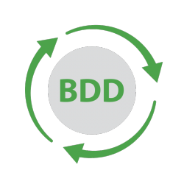

We Approach Our Question as a Binary Classification Problem
Source files added
Test files changed
Dependencies added
Source files renamed
Author Experience with BDD
….

Slide 34
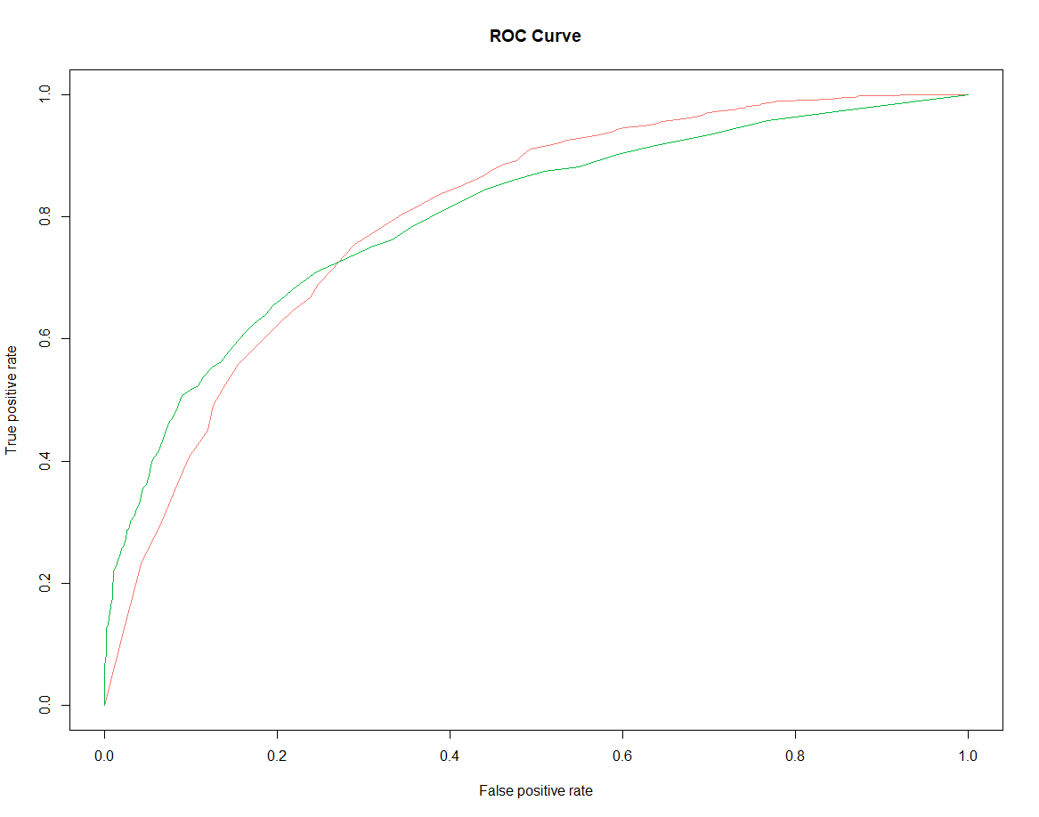
Our Top Performing Model Has 0.76 AUC
Area under the random forest ROC curve is AUC
Random Forest (0.76)
Naïve Bayes (0.74)
Logistic Regression (0.70)

Slide 35
Episode 3: Return of the RQs
(RQ1): Can we accurately identify co-changes between .feature files and source code ﬁles?
(RQ2): Can we accurately predict when co-changes between .feature files and source code ﬁles are necessary?
(RQ3): What are the most signiﬁcant characteristics for predicting co-changes between .feature files and source code files?

Slide 36




Obtain an AUC Value after Eliminating an Attribute
Source file added
Test file added
Other file added
Source file modified
Test file modified
AUC Decrease?

Slide 37
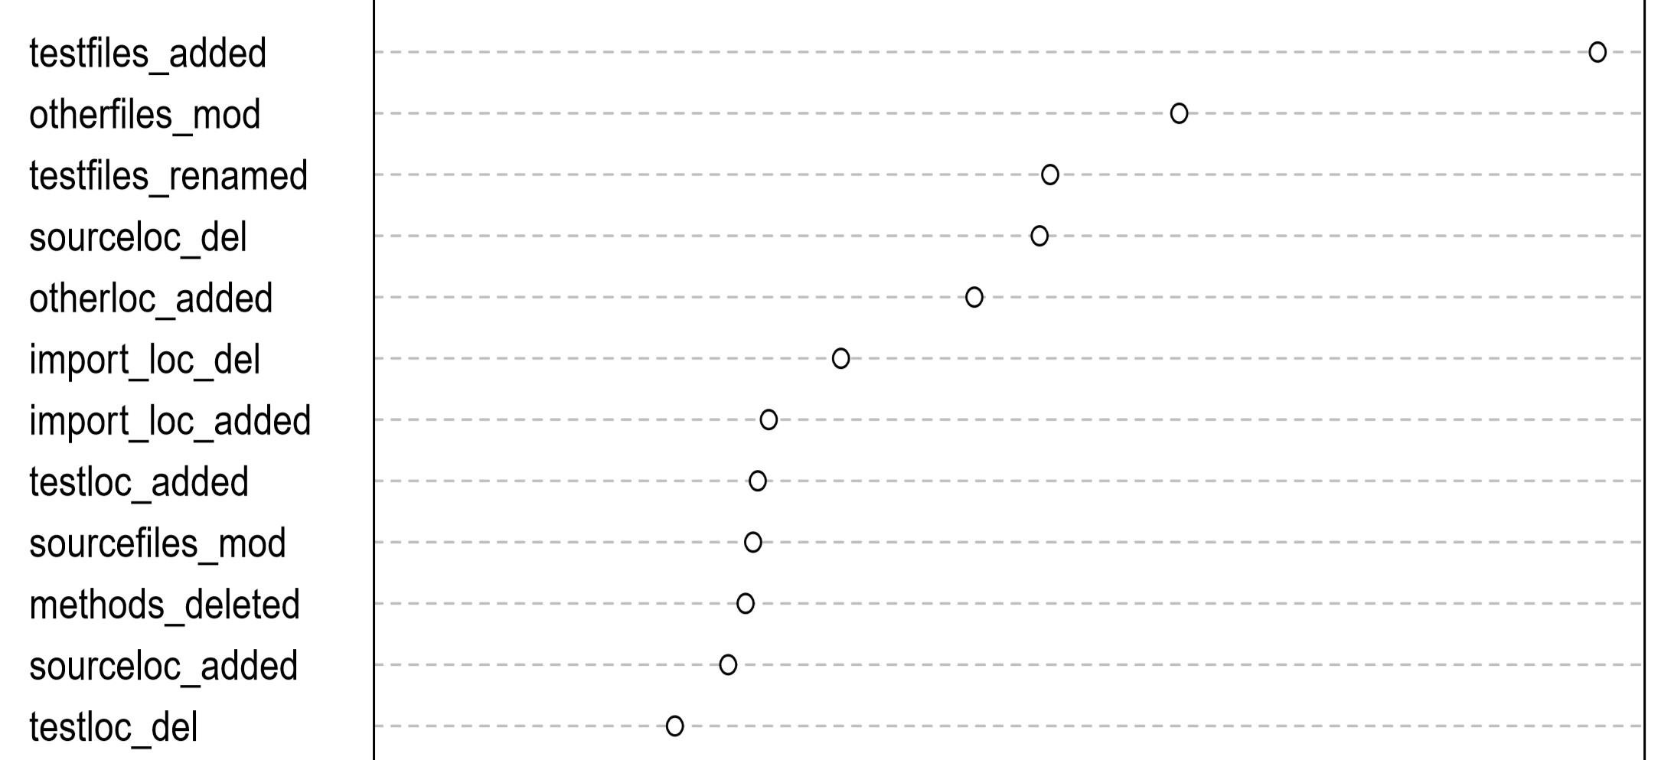
Test Files and All Other Files Changes Are the Strongest Predictors
Test files added
Other files modified
Test files re-named

Slide 38



Co-changes Can Be Detected and Predicted!
RQ1: We can detect BDD co-changes with 79% accuracy
RQ2: Our top classification technique yields a 0.76 AUC
RQ3: Test files added and renamed, and other files modified are strongest predictors
0.76 AUC
79%
Other Files Changed
Tests Renamed
Test Added

Slide 39






Modify .Feature Files to Maximize BDD Advantages When…
Adding and renaming test files
Modifying all other files
Modify .feature files!
Deleting source code

Slide 40
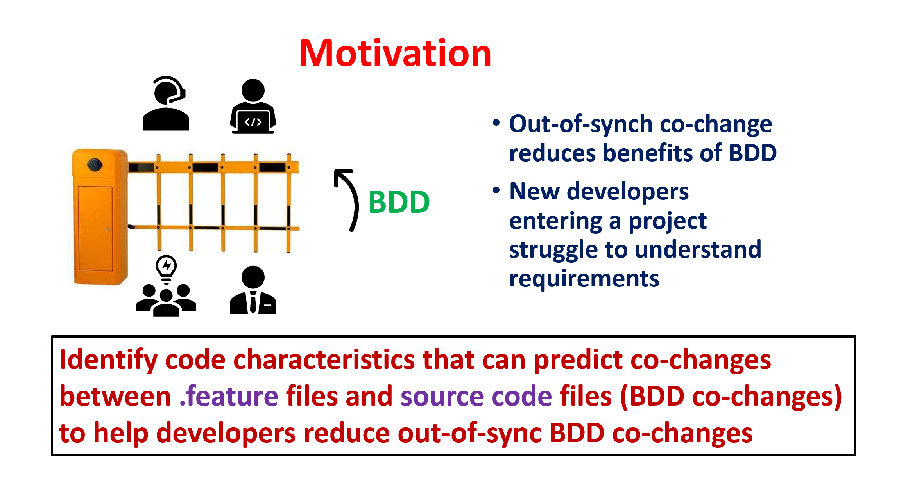
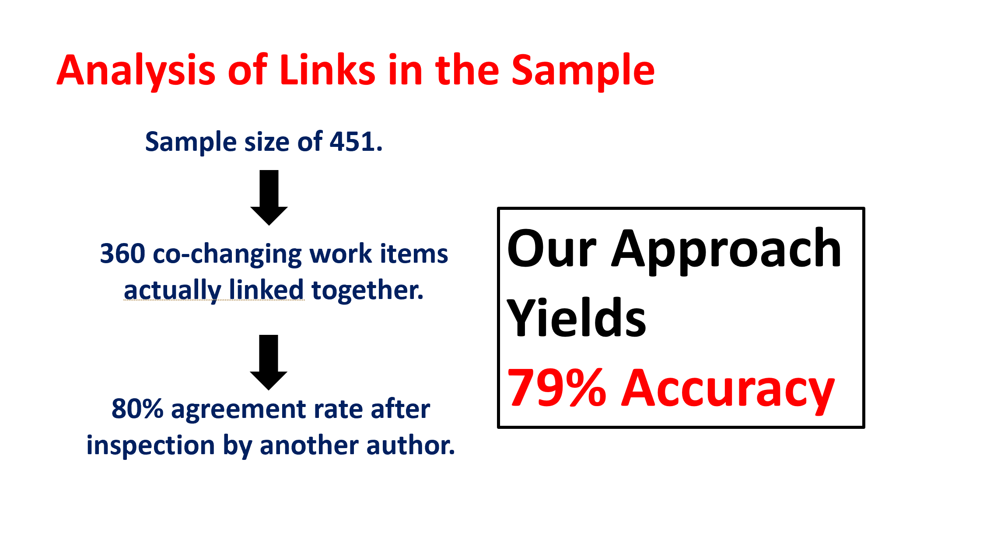
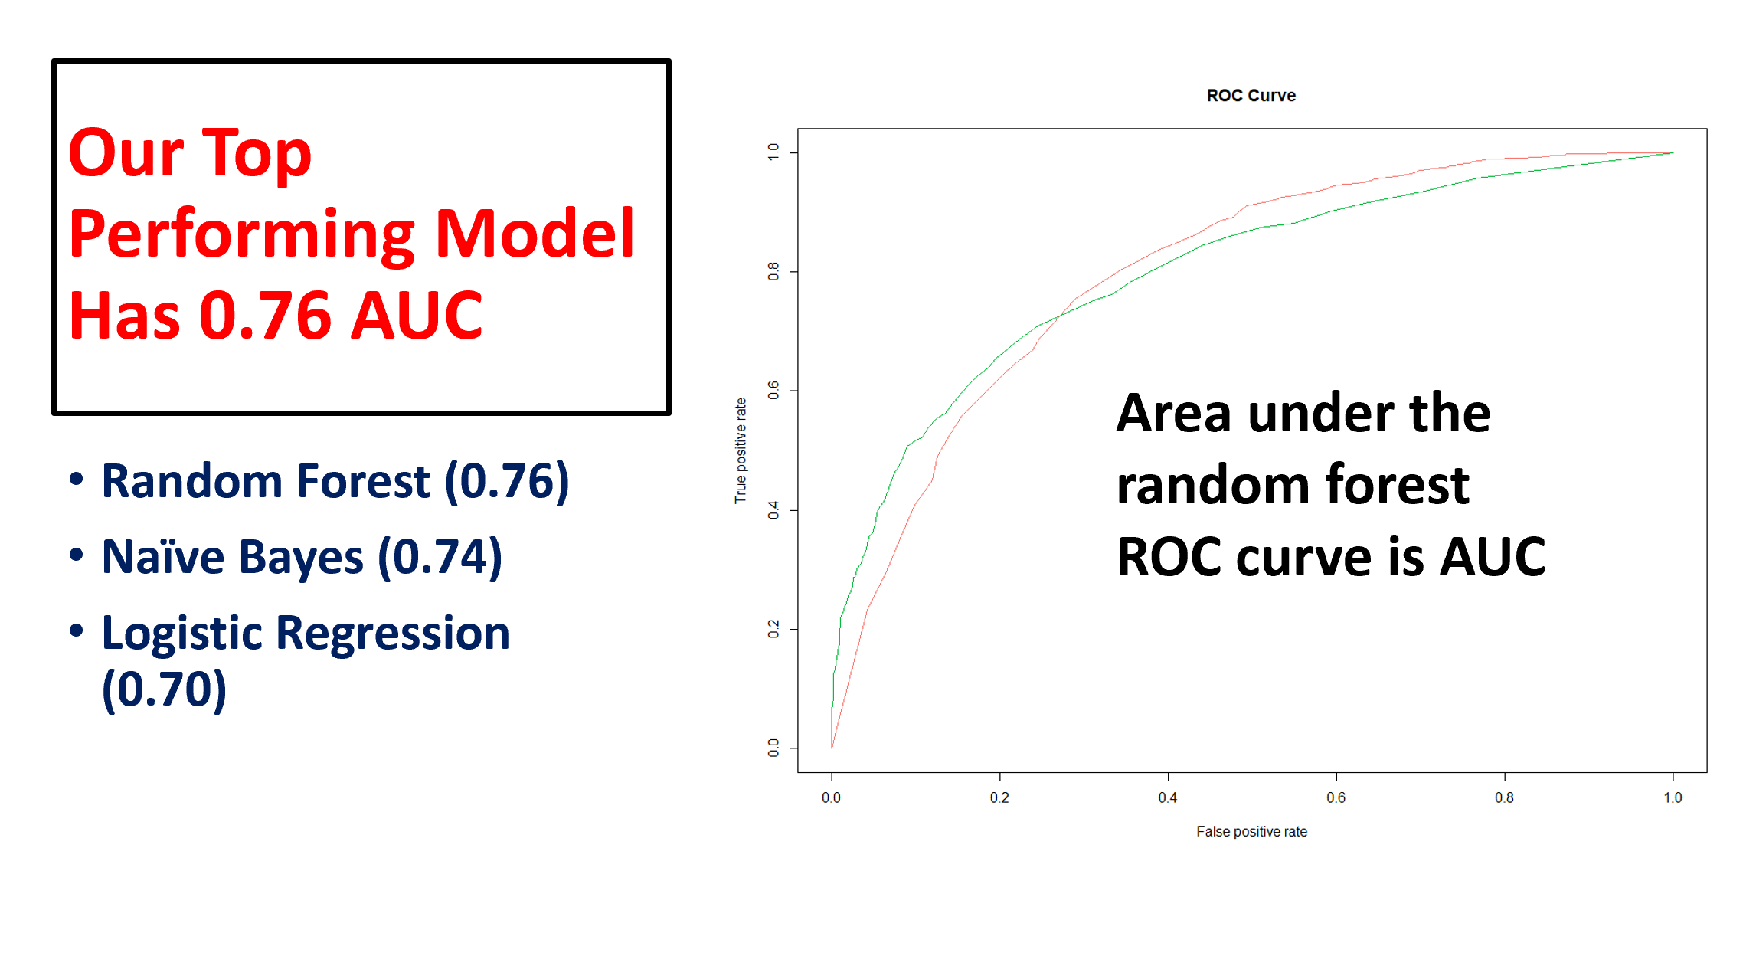
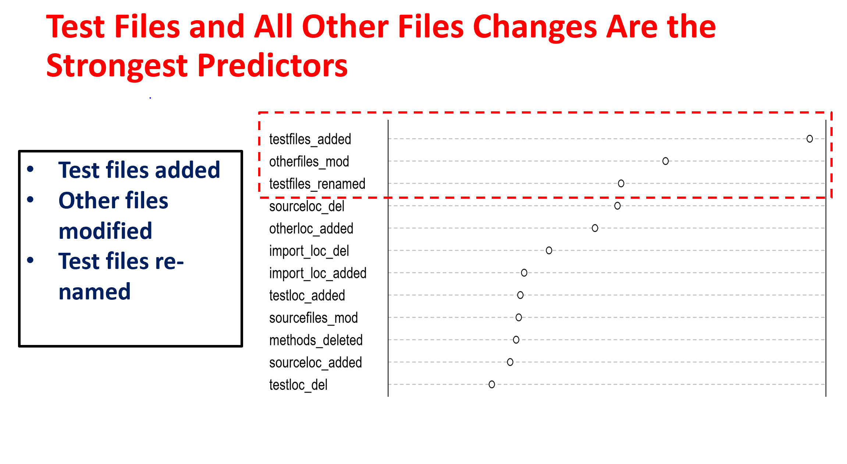
40

Slide 41





Predicting Co-Changes between Functionality Specifications and Source Code in Behavior Driven Development @ MSR19
Aidan Yang
Daniel A. da Costa
Ying Zou
Queen’s University
University of Otago
Queen’s University

Slide 42
VP: Try Compooters Me: Aight bet
Observations and Questions
Corporations strategize around quarterly earning reports.
Do software teams care about release documentation?
Yes!
Investors use earning reports to predict, analyze, and justify investment decisions.
Does release note writing style correspond with any software characteristics?
Also yes! Even how users perceive apps
Can software documentation and source code be traced?
Bankers and accountants audit clients’ financial health through tracing financial documents with SEC regulations.
In certain testing strategies, with some fancy NLP

Slide 43
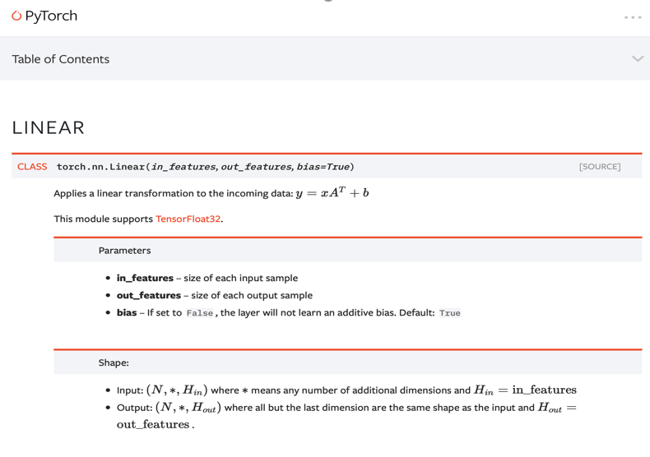

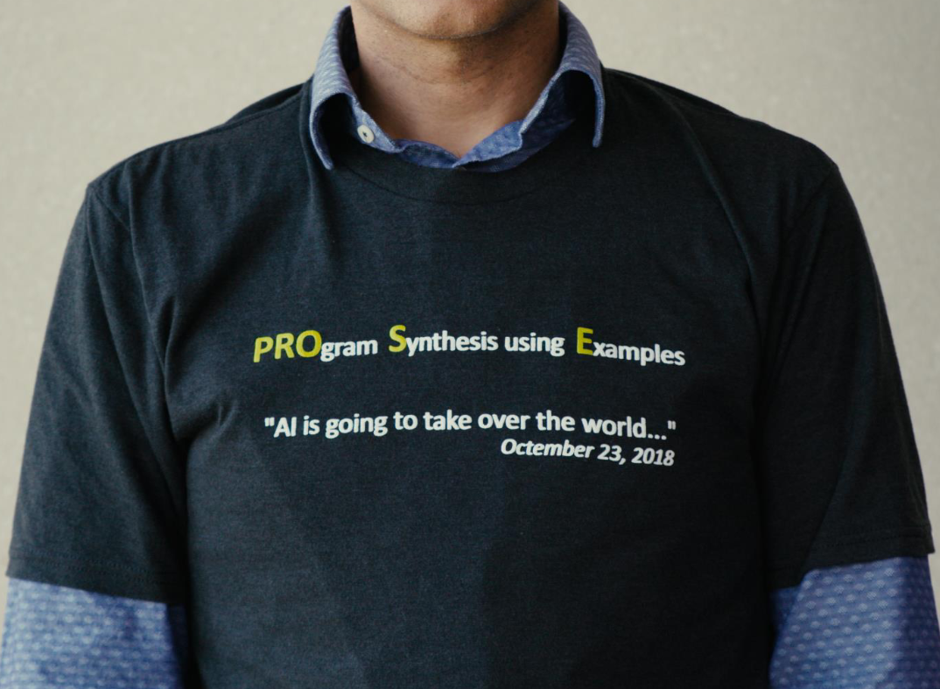

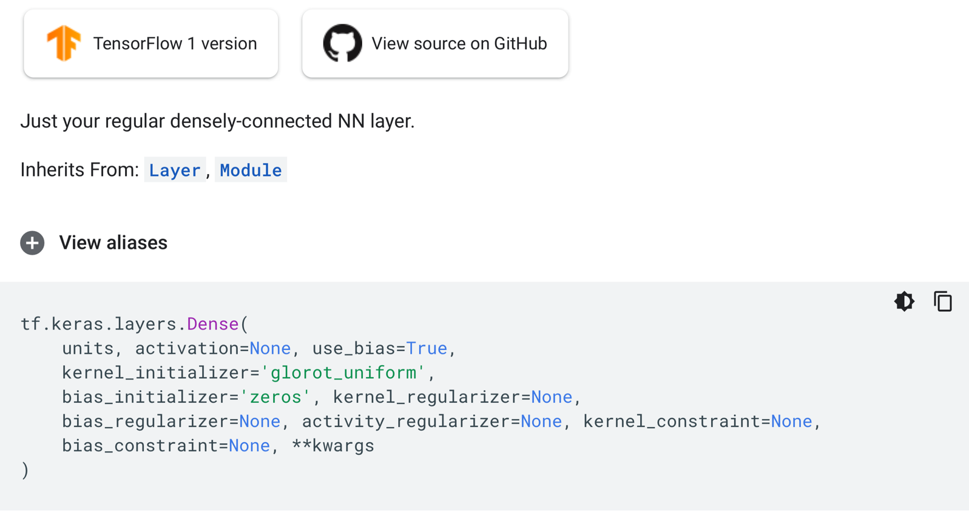
Parents: Back to Finance?

Slide 44


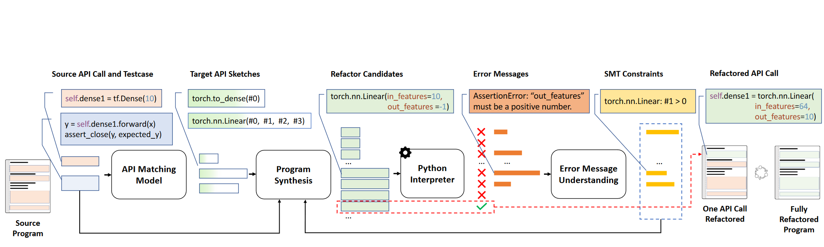

Claire Le : Try Com ters at CMU
Me: Aight Bet
Just when I thought I was out…
They pull me back in [Pacino90]

Slide 45




SOAR: A Synthesis Approach for Data Science API Refactoring @ ICSE21
Ansong Ni* Daniel Ramos* Aidan Yang Ines Lynce Vasco Manquinho
Ruben Martins Claire Le Goues

Slide 46

Questions?

